Slide 1
Lending Club Case Study
Notes:
This presentation was automatically generated by PowerPoint Copilot based on content found in this document:
https://visainc-my.sharepoint.com/:w:/r/personal/navcheru_visa_com/Documents/Naveen/Visa_Personal/Learning/UpGrad/CaseStudy/Lending%20Club%20Case%20Study_shashank_2024_0509.docx?d=wc161379764bd4f4d8f9d9aeb1559dfde&csf=1&web=1&e=SYeOHa

Slide 2
For ,
Institute of Information Technology, Bangalore
Upgrad Education
Prepared by,
Naveen Cheruku
Shashank Mishra
Notes:
This presentation was automatically generated by PowerPoint Copilot based on content found in this document:
https://visainc-my.sharepoint.com/:w:/r/personal/navcheru_visa_com/Documents/Naveen/Visa_Personal/Learning/UpGrad/CaseStudy/Lending%20Club%20Case%20Study_shashank_2024_0509.docx?d=wc161379764bd4f4d8f9d9aeb1559dfde&csf=1&web=1&e=SYeOHa

Slide 3
Agenda
Objective
Data Source
Approach
Data Cleaning and Manipulation
Data shortlisting required from Business Perspective
Data Conversion
Outlier analysis and Handling
Univariate Analysis and Outlier Handling
Segmented Univariate Analysis
Derived Metrics
Data points of Interest
Bivariate Analysis
Notes:
Agenda
* Objective
* Data Source
* Approach
* Data Cleaning and Manipulation
* Identification and Removal of Irrelevant Columns
* Missing values in rows
* Handling 'null' values
* Other Issues
* Data shortlisting required from Business Perspective
* Data Conversion
* Outlier analysis and Handling
* Univariate Analysis and Outlier Handling
* DTI - Debt to Income ratio
* Interest Rate
* Annual Income with Outliers in raw data
* Annual Income with 99th percentile outlier removed
* DTI - Debt to Income Ratio
* Loan_status
* Loan amount
* Term
* Interest rate
* Grade
* Sub-grade
* Employment Length
* Home ownership
* Verification status
* Annual Income
* Purpose
* Address State
* DTI - Debt to Income ratio
* Public record of Bankruptcy
* Derived Metric - Loan Issue Month
* Segmented Univariate Analysis
* Purpose
* Loan Amount vs Loan Status
* Loan Term vs Grade
* Derived Metrics
* Type Driven Metrics : int_rate_bin
* Type Driven Metrics : dti_bin
* Type Driven Metrics : installment
* Type Driven Metrics : annual_inc
* Data points of Interest
* Bivariate Analysis
* Multi-Variate Analysis
* Loan Amount vs Term vs loan_status
* Loan Amount vs Employment Length vs loan_status
* Correlation HeatMap
* Analysis Results
* Univariate Analysis
* Segmented Univariate Analysis
* Bivariate Analysis
* Suggestions and Recommendations
* Data points that can be used to predict whether there will be a default and avoiding Credit Loss
* With respect to borrowers following considerations can be considered as risk for 'defaults'

Slide 4
Objective
To assist Lending Club in mitigating credit losses by identifying high-risk loan applicants through Exploratory Data Analysis. The aim is to understand key factors leading to loan default, thereby enhancing portfolio and risk assessment.
Notes:
The goal is to help Lending Club reduce credit losses by identifying high-risk loan applicants through data analysis. By understanding the key factors that lead to loan default, we can improve portfolio and risk assessment.
Original Content:
The objective is to assist Lending Club in mitigating credit losses by identifying high-risk loan applicants through Exploratory Data Analysis. The aim is to understand key factors leading to loan default, thereby enhancing portfolio and risk assessment.

Slide 5

Data Source
Data provided in CSV file
Associated data dictionary explains meaning of data columns
Notes:
The data has been provided in the form of a CSV file. There is an associated data dictionary to explain the meaning of the various data columns present in the file.
Original Content:
The data has been provided in the form of a csv file. It has an associated Data dictionary to explain the meaning of various data columns present in the cs file.

Slide 6
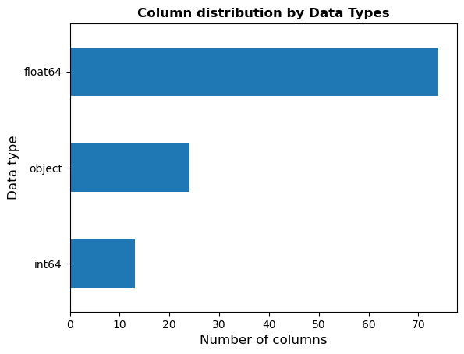
Approach
Data Cleaning
Remove irrelevant or incorrect data
Univariate Analysis
Analyze individual variables
Segmented Variate Analysis
Analyze variables by segment
Bivariate Analysis
Analyze relationship between two variables
Derived Metrics
Create new metrics from existing data
Collate and Conclude Findings
Summarize findings and provide suggestions
Notes:
Our approach to analyzing the raw data set involves several steps, including data cleaning, univariate and segmented variate analysis, bivariate analysis, and deriving metrics. We will then collate and conclude our findings to provide suggestions.
Original Content:
The approach we will follow is the standard approach to analyze a data set which is raw in nature. Hence we will apply the following methodologies to clean the data, understand the nature of data and arrive at a list of data columns which are required from a final analysis perspective. A list of steps that we are going to follow are as follows. Data sourcing has already been mentioned :
Data cleaning
Univariate Analysis
Segmented variate Analysis
BiVariate Analysis
Derived Metrics, if any
Collate and conclude on findings to arrive at suggestions

Slide 7
Data Cleaning and Manipulation: Identification and Removal of Irrelevant Columns
Columns with no unique values
tax_liens, delinq_amnt, chargeoff_within_12_mths, acc_now_delinq, application_type, policy_code, collections_12_mths_ex_med, initial_list_status, pymnt_plan
Columns with all unique values
id, url and member_id are all unique. We can use one of them as identifier and drop other two
Columns which are not useful
emp_title and title columns seem to be just designations. Hence they can be removed
Notes:
This slide lists the columns that can be removed from the dataset. These include columns with no unique values, columns with all unique values, and columns which are not useful. The specific columns are listed in the bullet points.
Original Content:
● Columns with no unique values tax_liens, delinq_amnt, chargeoff_within_12_mths, acc_now_delinq, application_type, policy_code, collections_12_mths_ex_med, initial_list_status, pymnt_plan
● Columns with All unique values id, url and member_id are all unique. We can use one of them as identifier and drop other two
● Columns which are not useful emp_title and title columns seem to be just designations. Hence they can be removed

Slide 8

Data Cleaning and Manipulation: Missing values in rows
Check maximum number of missing values in a row
Ignore if less than 5
Number of null values in irrelevant columns
Leave for now, drop in final evaluation
Notes:
In this slide, we discuss how to handle missing values. We check the maximum number of missing values in a row and ignore it if it's less than 5. The number of null values seem to be in irrelevant columns, so we leave them for now and drop them in our final evaluation.
Original Content:
● Check what is the maximum number of missing values in a row. If it is a small number say less than 5. Ignore it
● The number of null values seem to be in irrelevant columns which we will drop in our final evaluation of important columns. Hence, leaving them be for now

Slide 9
Data Cleaning and Manipulation: Handling 'null' values
Evaluate Imputation of Null Values
Check if null values can be imputed
If not, remove them
Notes:
In this step, we will evaluate whether we can impute null values in our data. If it is not possible, we will remove them to ensure data quality.
Original Content:
● Evaluate whether we can impute 'null' values. If not, remove them

Slide 10
Data Cleaning and Manipulation: Other Issues
Remove padded spaces from 'Term' column
Notes:
The 'Term' column has padded spaces that need to be removed.
Original Content:
● 'Term' column has padded spaces in it which needs to be removed

Slide 11
Data shortlisting required from Business Perspective
Relevant attributes help make decision before loan sanction
Columns representing data gathered after loan sanction are dropped
Loans with status Current are removed
Zip_code is a masked column and is dropped
Irrelevant attributes are removed
Only Fully paid or Charged Off loans are required
Examples: delinq_2yrs, earliest_cr_line, inq_last_6mths
Funded_amnt_inv is internal data and not required
Notes:
The slide discusses the relevance of loan attributes in making a decision to provide a loan. Relevant attributes are those that help make a decision before the loan is sanctioned, while irrelevant attributes are removed. Loans with status Current are also removed, and only Fully paid or Charged Off loans are required. Certain columns representing data gathered after the loan is sanctioned are dropped, such as delinq_2yrs, earliest_cr_line, and inq_last_6mths. Zip_code is a masked column and is dropped, while Funded_amnt_inv is internal data and not required for making a decision.
Original Content:
The basis for revisiting the leftover column is to check whether they are relevant customer attributes or loan attributes which are useful to make a decision whether to provide the loan or not. So, any column which helps us to make a decision 'before' loan sanction, is 'relevant' otherwise it is irrelevant.
● In order to make a decision on whether to Lend money or not, the Loans which are currently being serviced are not counted. Only the loans which are Fully paid or Charged Off are required. Hence, we will remove the Loans with status Current
● As per provided Data Dictionary following columns represent some data which is gathered after the Loan is sanctioned and hence we will drop these columns 'delinq_2yrs', 'earliest_cr_line', 'inq_last_6mths', 'open_acc', 'pub_rec', 'revol_bal', 'revol_util', 'total_acc', 'out_prncp', 'out_prncp_inv', 'total_pymnt', 'total_pymnt_inv', 'total_rec_prncp', 'total_rec_int', 'total_rec_late_fee', 'recoveries', 'collection_recovery_fee', 'last_pymnt_d', 'last_pymnt_amnt','last_credit_pull_d'
● 'Zip_code' is Masked column, hence it will be dropped
● 'Funded_amnt_inv’ is Internal data of the Company, not required for making decision
● In order to make a decision on whether to Lend money or not, the Loans which are currently being serviced are not counted. Only the loans which are Fully paid or Charged Off are required. Hence, we will remove the Loans with status Current

Slide 12

Data Conversion
Term column
Convert to 'int' after removing string literal 'months'
Grade column
Convert to 'category' type
Sub_grade column
Emp_length column
Home_ownership column
Verification_status column
Purpose column
Addr_state column
Issue_d
Int_rate column
Notes:
In this slide, we will discuss the data cleaning and conversion process. The term column needs to be converted to an integer after removing the string literal 'months'. The grade, sub_grade, home_ownership, verification_status, purpose, and addr_state columns can all be converted to the 'category' type. The emp_length column needs to keep only the number part and drop any string or alphanumeric. The issue_d can be converted to a datetime format. Lastly, the int_rate column has a '%' sign in it, which needs to be removed and the data type needs to be converted to float.
Original Content:
● term column needs to be converted to 'int' after removing string literal 'months'
● grade column can be converted to 'category' type
● sub_grade column can be converted to 'category' type
● emp_length column needs to keep only number part and drop any string or alphanumeric
● home_ownership column can be converted to 'category' type
● verification_status column can be converted to 'category' type
● purpose column can be converted to 'category' type
● addr_state column can be converted to 'category' type
● issue_d can be converted to 'datetime'
● int_rate columns has '%' sign in it. This needs to be removed. Also, data type needs to be converted to float

Slide 13
Outlier analysis and Handling
Outlier Check Performed on Continuous Variables
Loan Amount
Interest Rate
Annual Income
DTI - Debt to Income Ratio
Outliers Handled for Annual Income
Data Made Uniformly Distributed
Notes:
An outlier check was performed on continuous variables such as loan amount, interest rate, annual income, and DTI. Outliers were handled for annual income to make the data uniformly distributed.
Original Content:
Outlier check was performed on following continuous variables and handled for Annual income to make data uniformly distributed
Loan amount
Interest rate
Annual Income
DTI - Debt to Income ratio

Slide 14

Univariate Analysis
Notes:
Loan Amounts
Range from 500 to 35000
Mean of 9800
Loan Terms
75% have a term of 36 months
25% have a term of 60 months
Interest Rates
Most common rates are 5-10 and 10-15
Loan Grades
High Grade Loans are most common
Borrower Employment Length
Borrower Accommodation

Slide 15
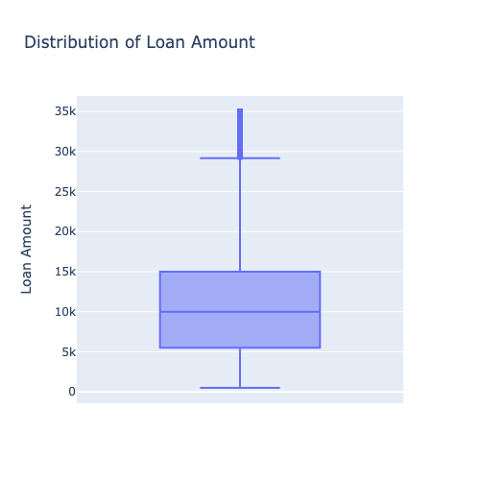
Univariate Analysis and Outlier Handling: DTI - Debt to Income ratio
DTI - Debt to Income ratio
Notes:
DTI stands for Debt to Income ratio.
Original Content:
DTI - Debt to Income ratio

Slide 16
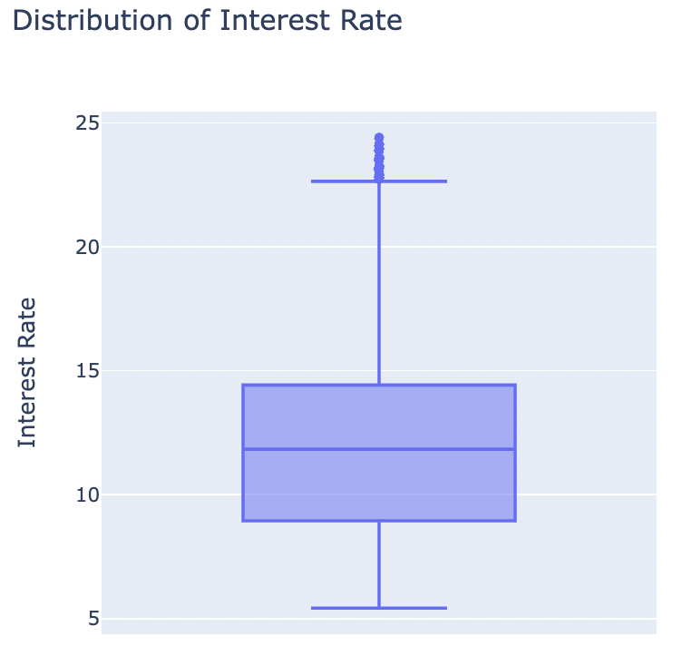
Univariate Analysis and Outlier Handling: Interest Rate
Interest Rate
Notes:
This slide is about interest rates.
Original Content:
Interest Rate

Slide 17
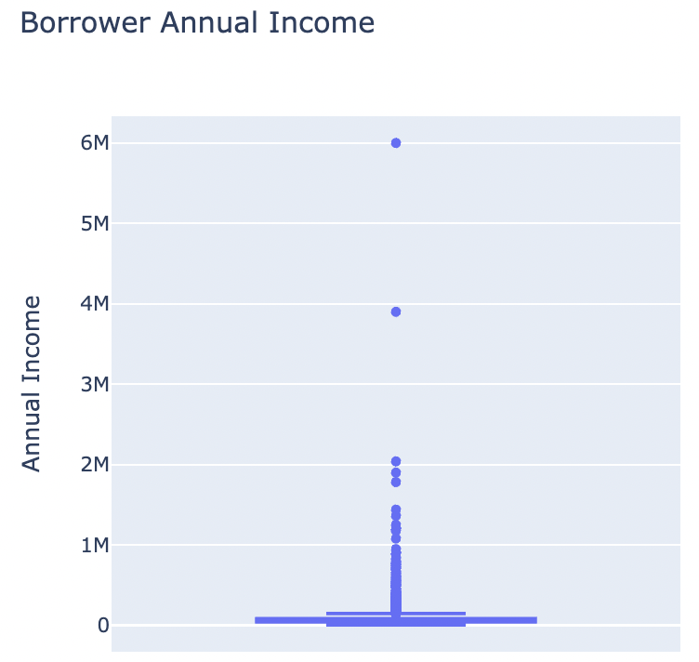
Univariate Analysis and Outlier Handling: Annual Income with Outliers in raw data
3. Annual Income with Outliers in raw data
Notes:
This slide discusses the annual income with outliers present in the raw data.
Original Content:
3. Annual Income with Outliers in raw data

Slide 18
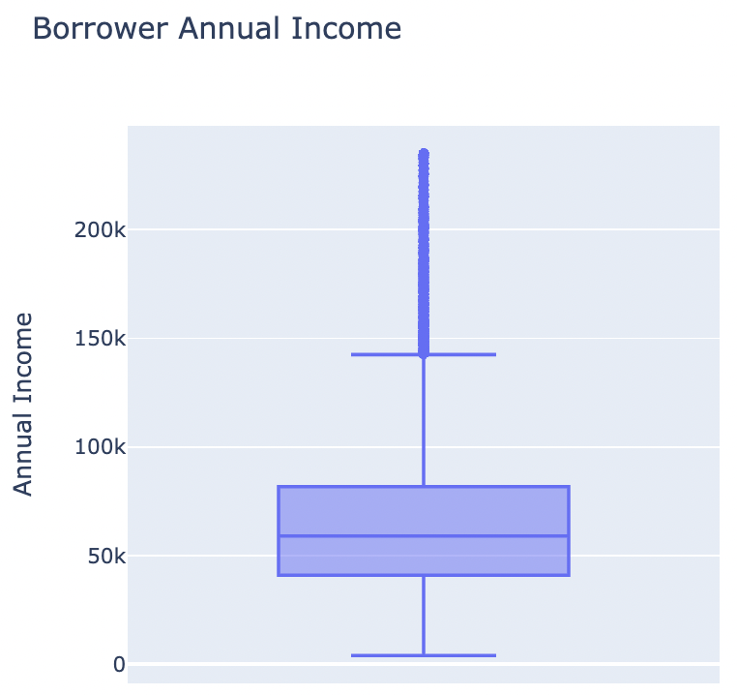
Univariate Analysis and Outlier Handling: Annual Income with 99th percentile outlier removed
4. Annual Income with 99th percentile outlier removed
Notes:
This slide presents information on annual income with the 99th percentile outlier removed.
Original Content:
4. Annual Income with 99th percentile outlier removed

Slide 19
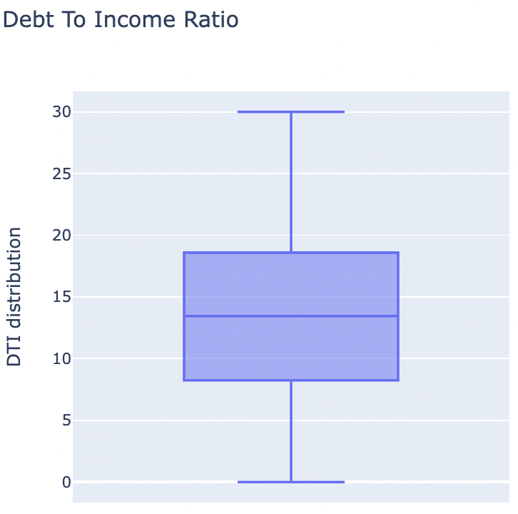
Univariate Analysis and Outlier Handling: DTI - Debt to Income Ratio
5. DTI - Debt to Income Ratio
Notes:
This slide is about DTI, which stands for Debt to Income Ratio.
Original Content:
5. DTI - Debt to Income Ratio

Slide 20
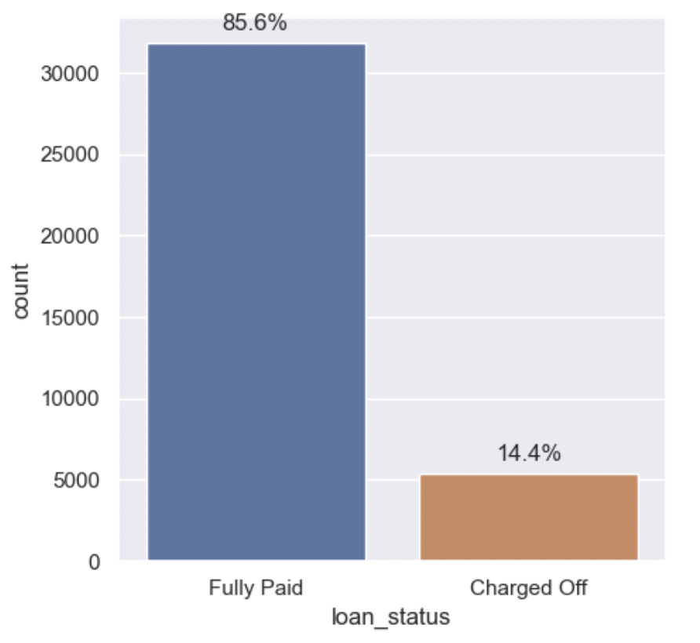
Univariate Analysis and Outlier Handling: Loan_status
Loan_status is the target column for analysis
Comparison with other columns
Analysis of Customer and Loan attributes
Notes:
In this analysis, we will focus on the loan_status column and compare it with other columns, specifically customer and loan attributes.
Original Content:
6. Loan_status
The target column for our analysis.
Further we will try to find out how loan_status compares with other columns (Customer and Loan attributes)

Slide 21
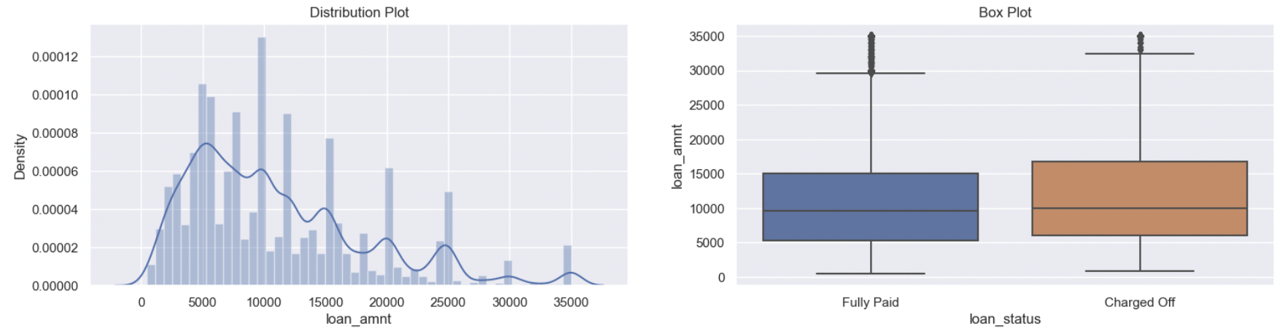
Univariate Analysis and Outlier Handling: Loan amount
7. loan amount
Notes:
This slide is about the loan amount.
Original Content:
7. loan amount

Slide 22
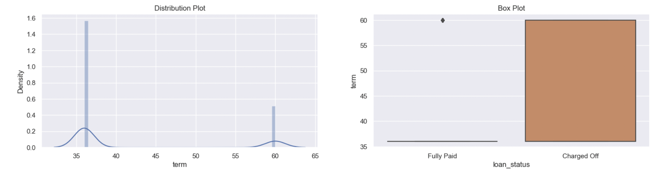
Univariate Analysis and Outlier Handling: Term
8. term
Notes:
This slide is about term 8. Unfortunately, there is not enough information to provide further details.
Original Content:
8. term

Slide 23
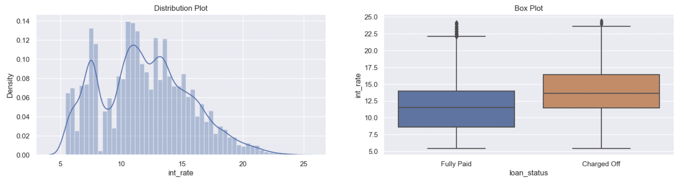
Univariate Analysis and Outlier Handling: Interest rate
9. Interest rate
Notes:
This slide is about interest rate.
Original Content:
9. Interest rate

Slide 24
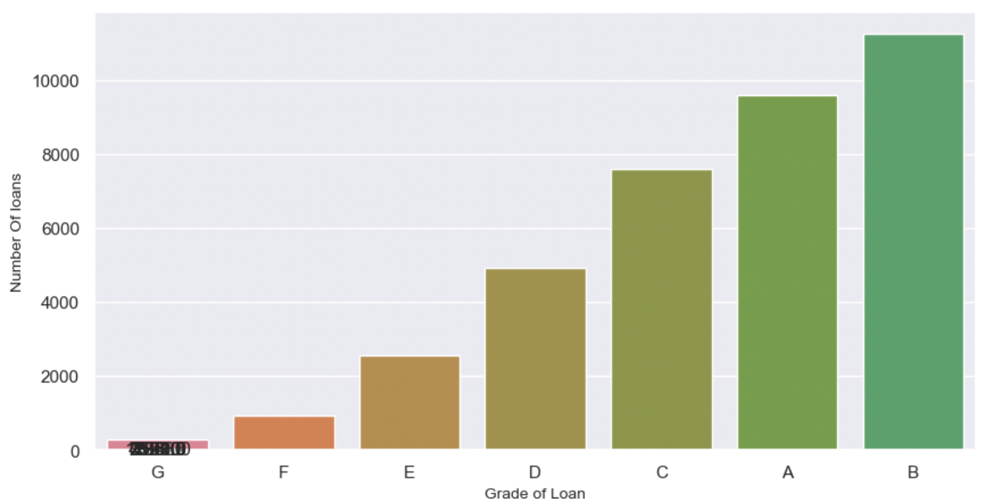
Univariate Analysis and Outlier Handling: Grade
10. Grade
Notes:
This slide is about grade 10.
Original Content:
10. Grade

Slide 25
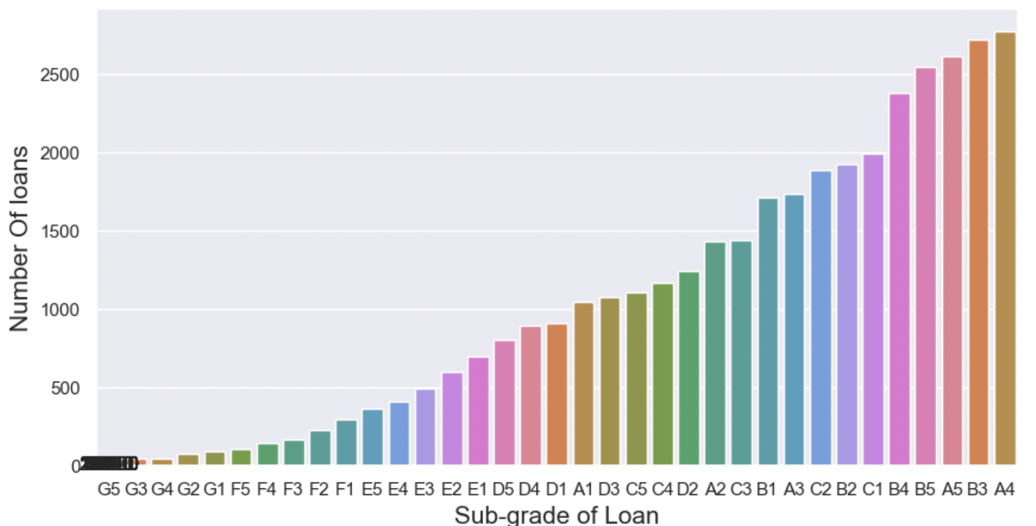
Univariate Analysis and Outlier Handling: Sub-grade
11. Sub-grade
Notes:
This slide is about sub-grade.
Original Content:
11. Sub-grade

Slide 26
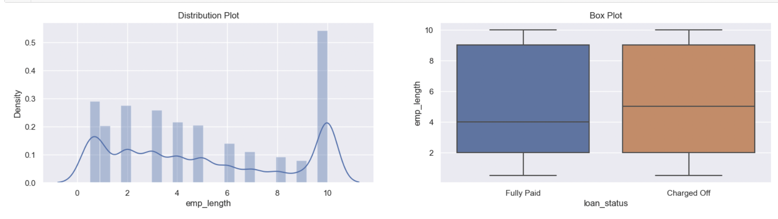
Univariate Analysis and Outlier Handling: Employment Length
12. Employment Length
Notes:
This slide is about employment length.
Original Content:
12. Employment Length

Slide 27
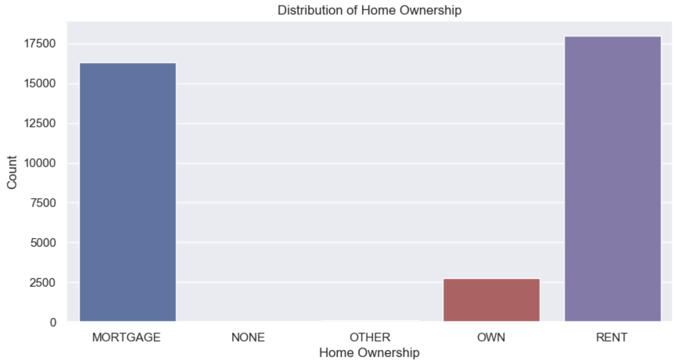
Univariate Analysis and Outlier Handling: Home ownership
13. Home ownership
Notes:
This slide is about home ownership.
Original Content:
13. Home ownership

Slide 28
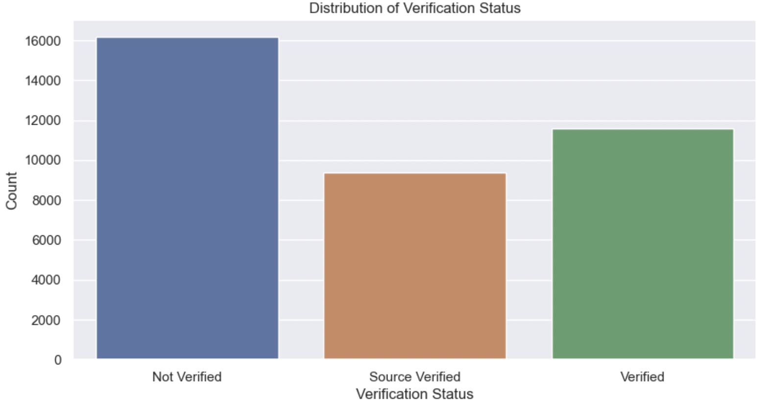
Univariate Analysis and Outlier Handling: Verification status
14. Verification status
Notes:
This slide is about verification status.
Original Content:
14. Verification status

Slide 29
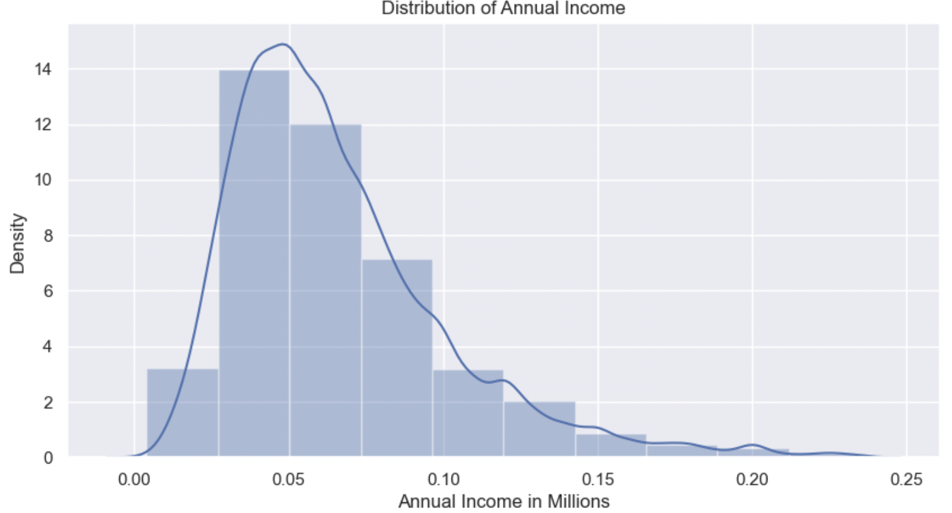
Univariate Analysis and Outlier Handling: Annual Income
15. Annual Income
Notes:
This slide presents information about annual income.
Original Content:
15. Annual Income

Slide 30
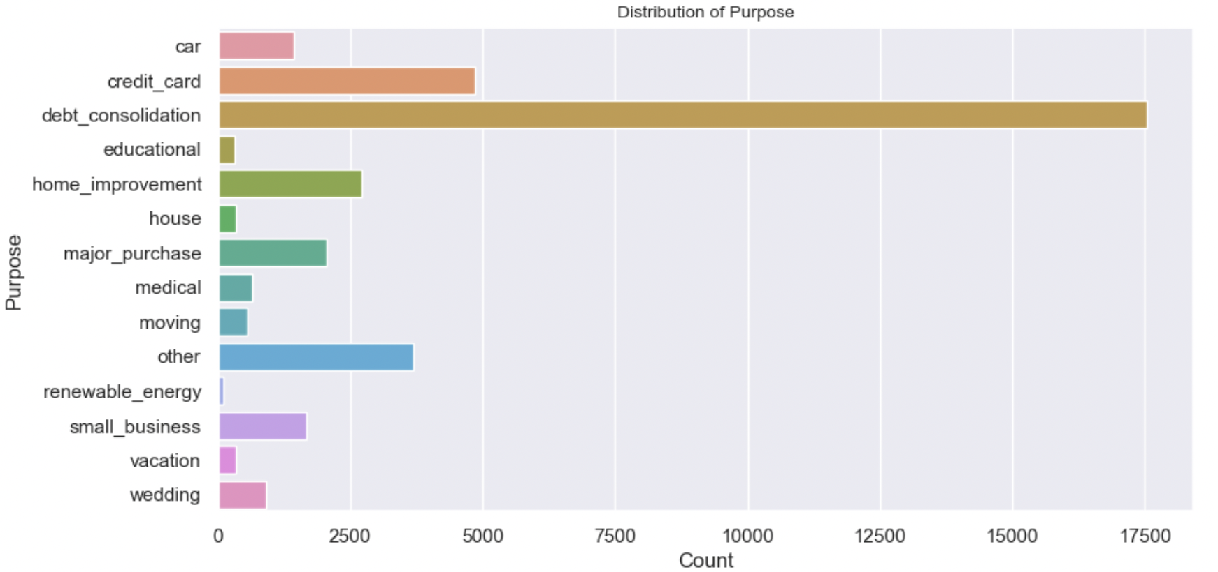
Univariate Analysis and Outlier Handling: Purpose
16. Purpose
Notes:
This slide is about the purpose of something, but more information is needed to elaborate further.
Original Content:
16. Purpose

Slide 31
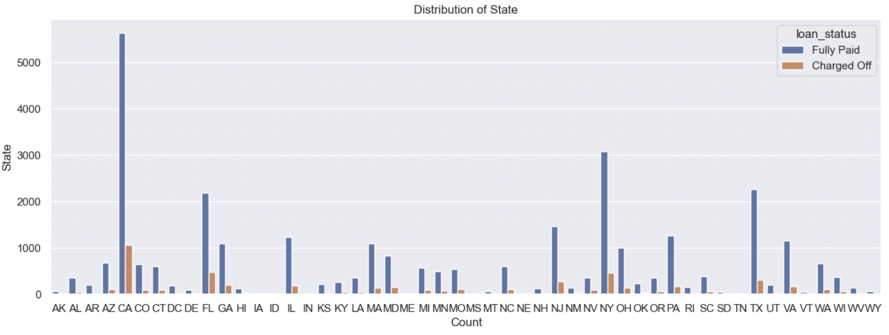
Univariate Analysis and Outlier Handling: Address State
17. Address State
Notes:
This slide is about the address state.
Original Content:
17. Address State

Slide 32
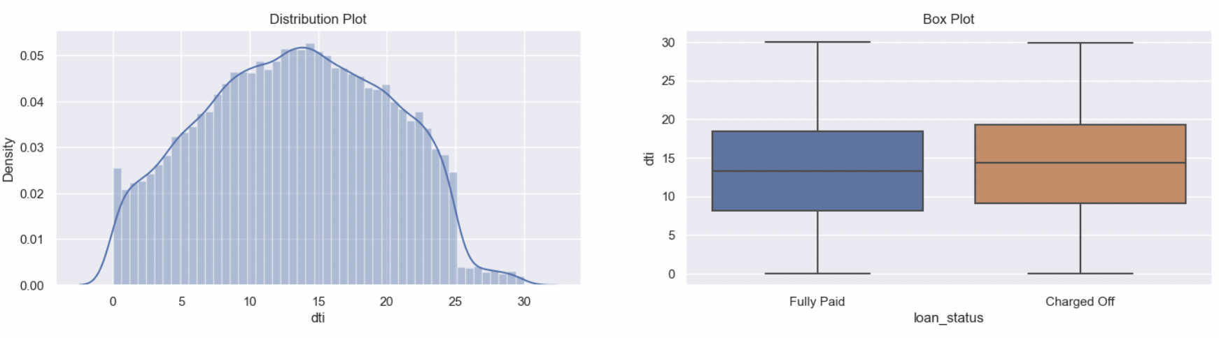
Univariate Analysis and Outlier Handling: DTI - Debt to Income ratio
18. DTI - Debt to Income ratio
Notes:
DTI stands for Debt to Income Ratio. It is a measure of an individual's ability to manage their debt payments relative to their income.
Original Content:
18. DTI - Debt to Income ratio

Slide 33
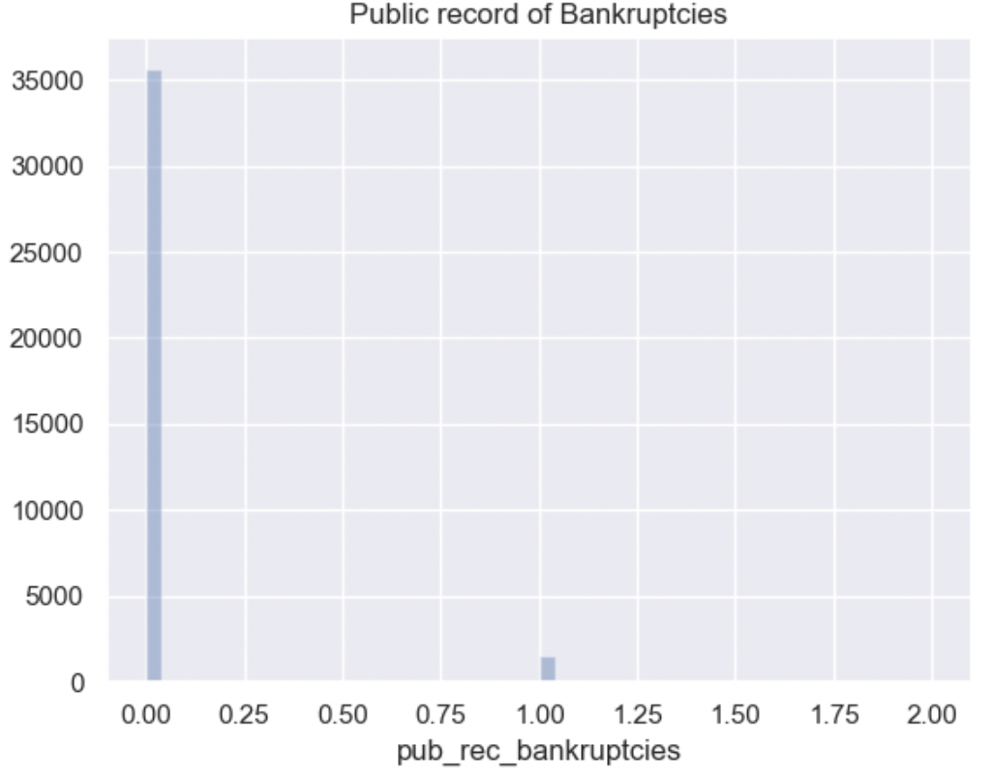
Univariate Analysis and Outlier Handling: Public record of Bankruptcy
19. Public record of Bankruptcy
Notes:
This slide discusses the public record of bankruptcy.
Original Content:
19. Public record of Bankruptcy

Slide 34
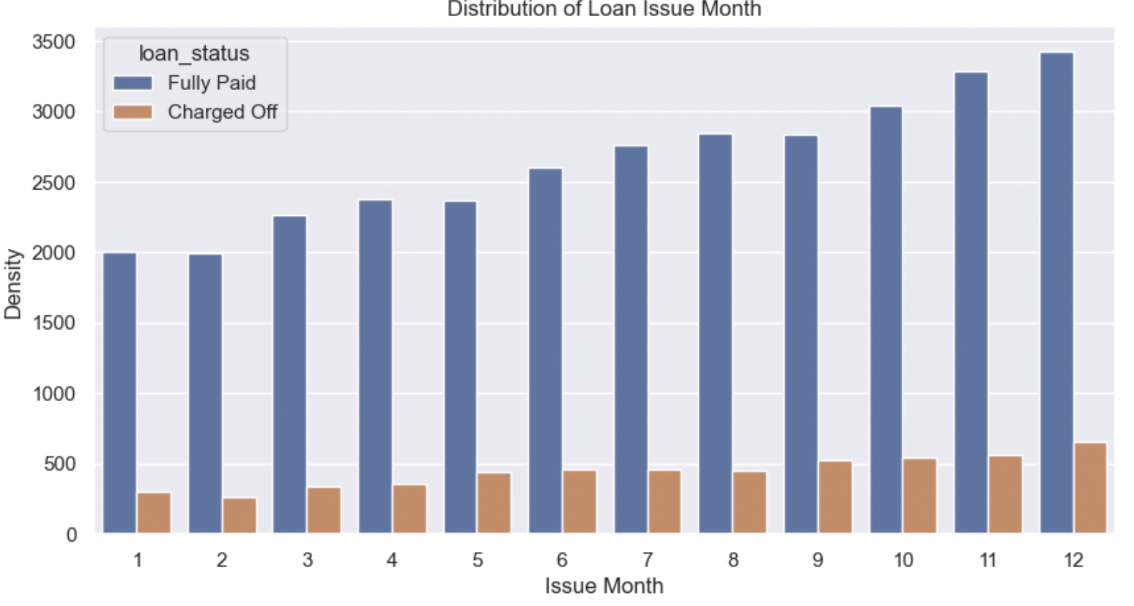
Univariate Analysis and Outlier Handling: Derived Metric - Loan Issue Month
20. Derived Metric - Loan Issue Month
Notes:
This slide is about the derived metric of loan issue month.
Original Content:
20. Derived Metric - Loan Issue Month

Slide 35
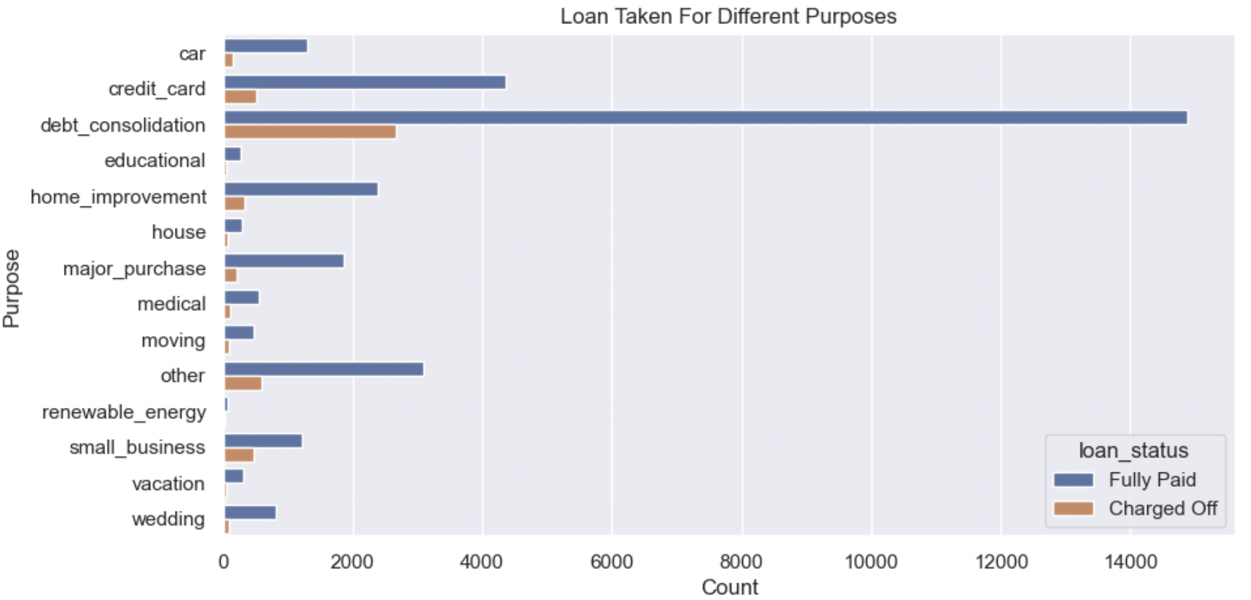
Segmented Univariate Analysis: Purpose
Purpose
Notes:
The purpose of this slide is not clear as there is not enough information provided.
Original Content:
Purpose

Slide 36
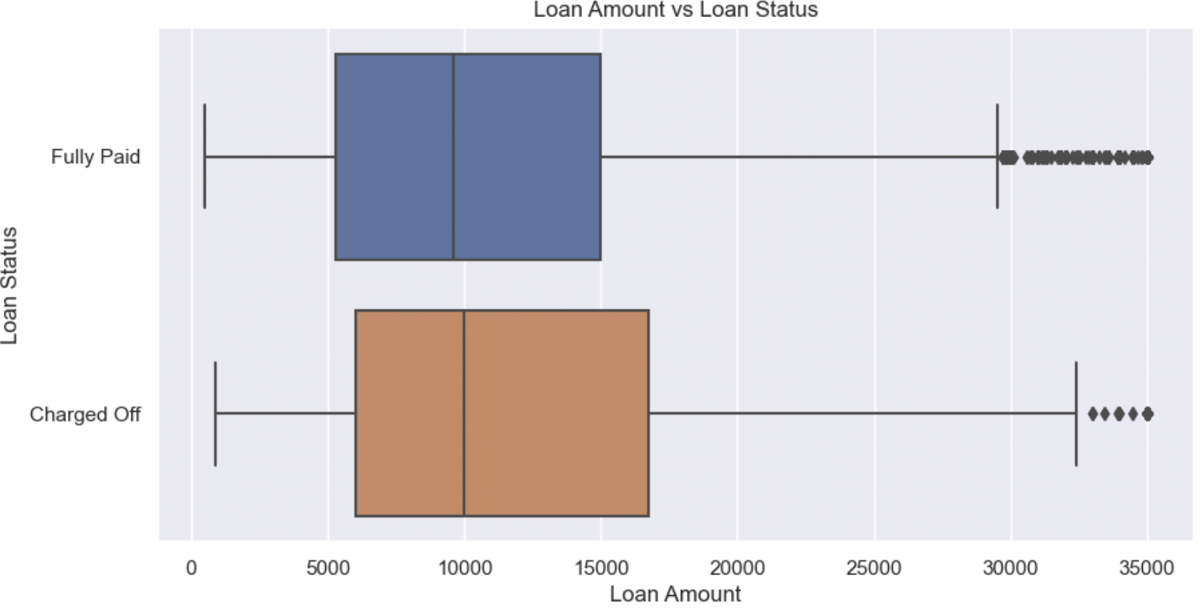
Segmented Univariate Analysis: Loan Amount vs Loan Status
Loan Amount vs Loan Status
Notes:
This slide presents a comparison between loan amount and loan status.
Original Content:
Loan Amount vs Loan Status

Slide 37
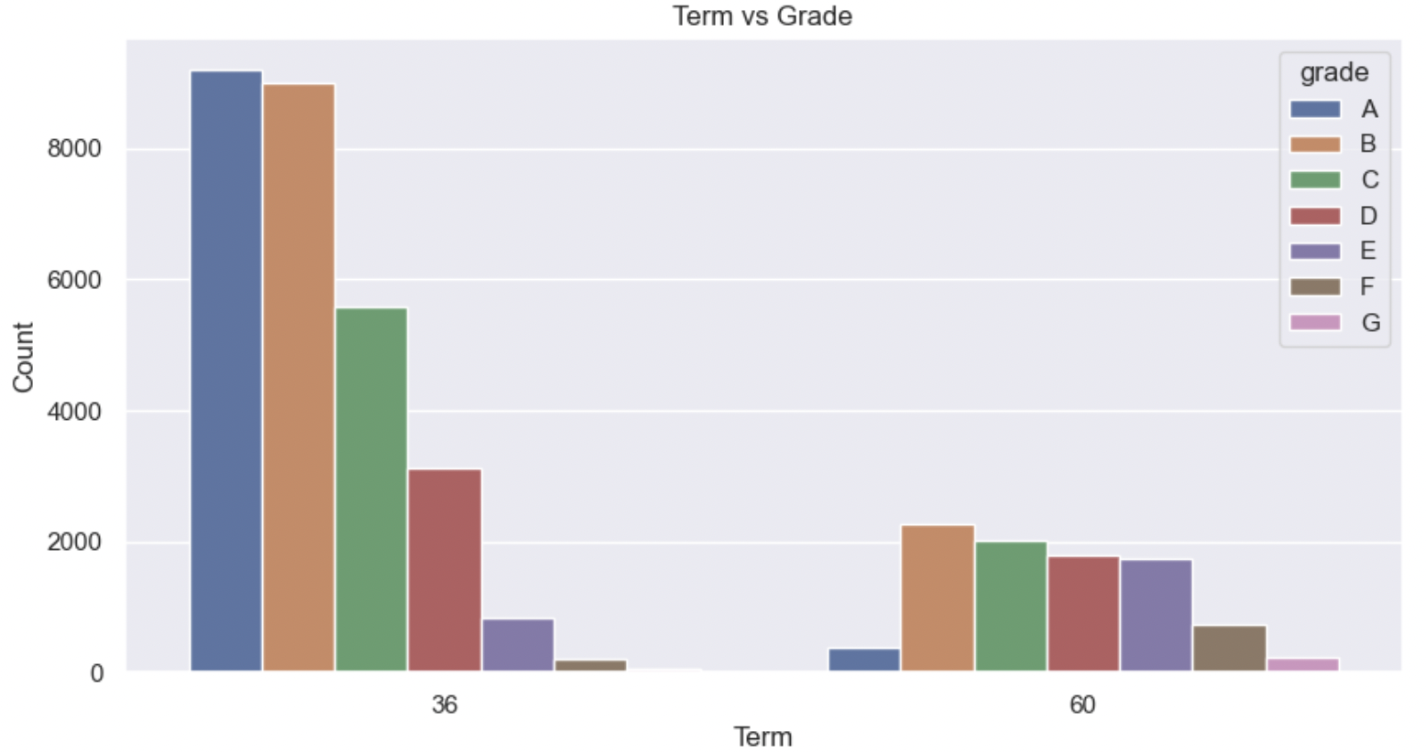
Segmented Univariate Analysis: Loan Term vs Grade
Loan Term vs Grade
Notes:
This slide presents a comparison between loan term and grade.
Original Content:
Loan Term vs Grade

Slide 38
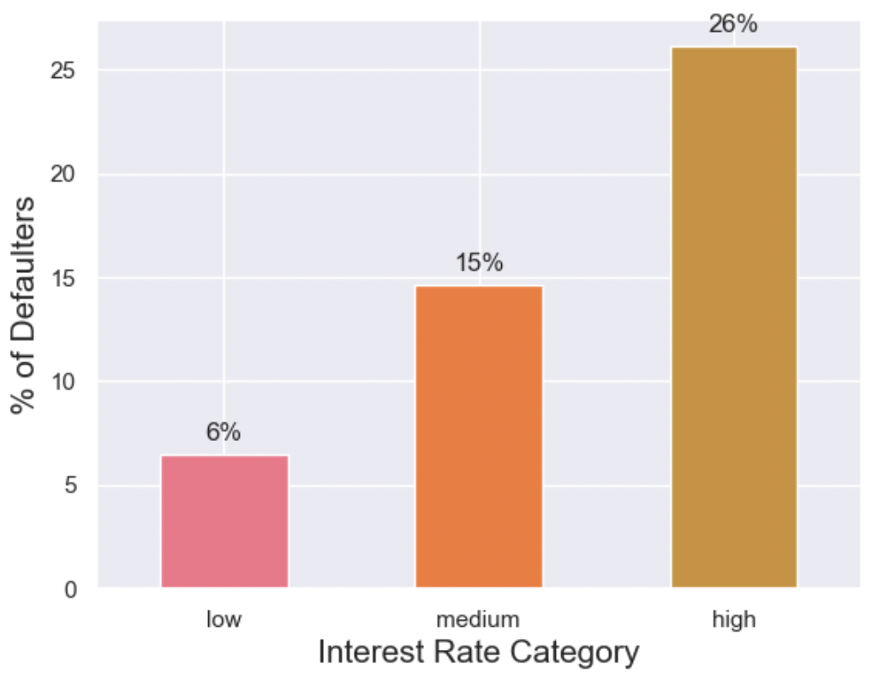
Type Driven Metrics : int_rate_bin
Type Driven Metrics : int_rate_bin
Notes:
Original Content:
Type Driven Metrics : int_rate_bin

Slide 39
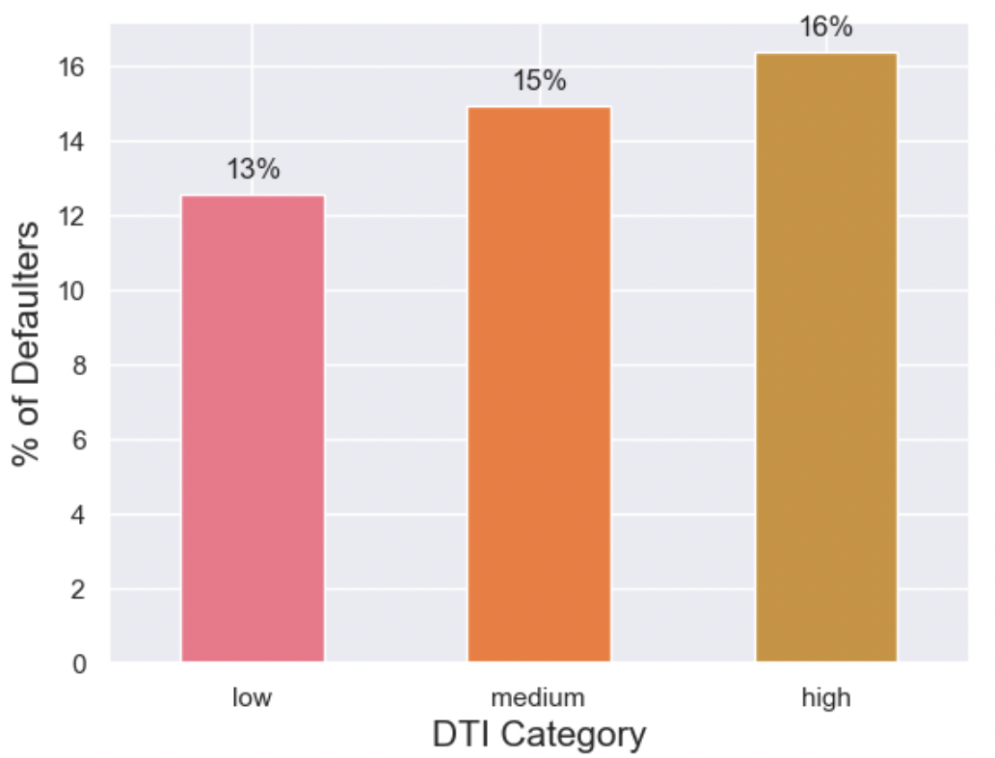
Type Driven Metrics : dti_bin
Type Driven Metrics : dti_bin
Notes:
This slide is about Type Driven Metrics and dti_bin.
Original Content:
Type Driven Metrics : dti_bin

Slide 40
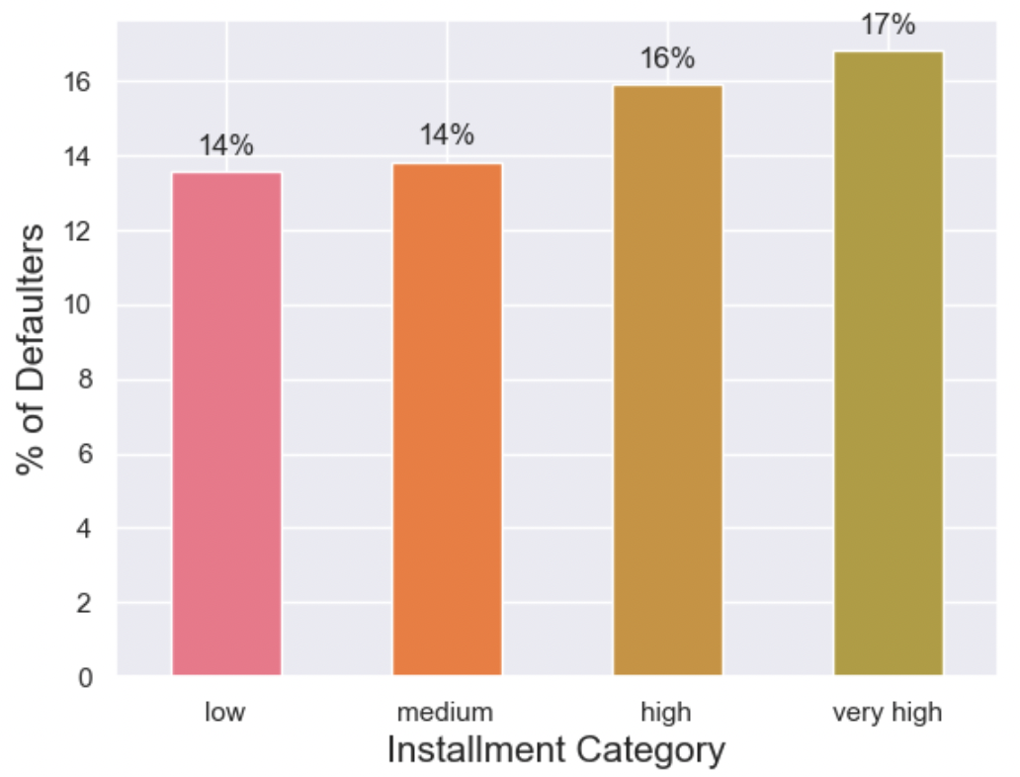
Type Driven Metrics : installment
Type Driven Metrics : installment
Notes:
This slide is about Type Driven Metrics and its installment.
Original Content:
Type Driven Metrics : installment

Slide 41
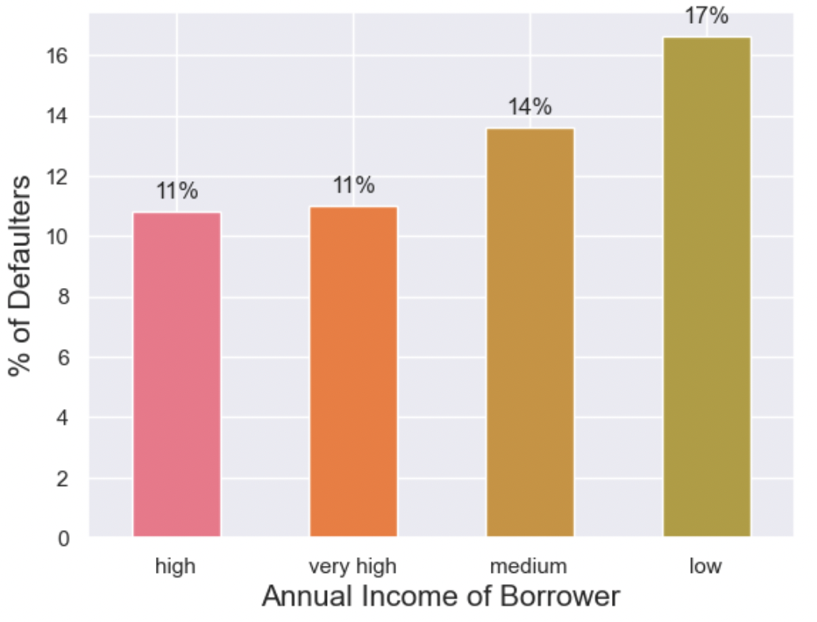
Type Driven Metrics : annual_inc
Type Driven Metrics : annual_inc
Notes:
This slide is about type driven metrics, specifically focusing on annual income.
Original Content:
Type Driven Metrics : annual_inc

Slide 42

Data points of Interest
Loan Amount (loan_amnt)
Purpose (purpose)
Home Ownership (home_ownership)
Issue Date (issue_d)
Sub-Grade (sub_grade)
Term (term)
Annual Income (annual_inc)
DTI (dti)
Public Record Bankruptcies (pub_rec_bankruptcies)
Employment Length (emp_length)
Notes:
Our univariate analysis suggests that variables such as Loan Amount, Purpose, Home Ownership, Issue Date, Sub-Grade, Term, Annual Income, DTI, Public Record Bankruptcies, and Employment Length can be considered for bivariate analysis.
Original Content:
As per our univariate analysis, following variables can be considered for bivariate analysis
● Loan Amount (loan_amnt)
● Purpose (purpose)
● Home Ownership (home_ownership)
● Issue Date (issue_d)
● Sub-Grade (sub_grade)
● Term (term)
● Annual Income (annual_inc)
● DTI (dti)
● Public Record Bankruptcies (pub_rec_bankruptcies)
● Employment Length (emp_length)

Slide 43
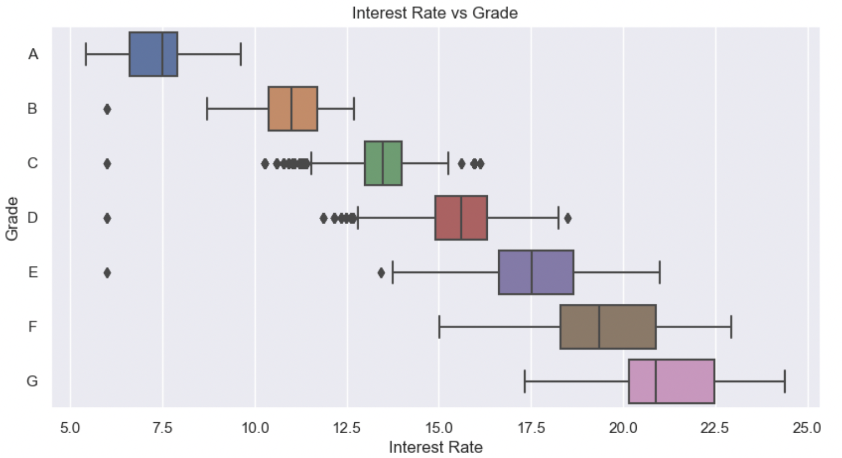
Bivariate Analysis
Lower Grade = Higher Risk
Lower grade with high interest rate increases the risk
Notes:
In this bivariate analysis, we can see that a lower grade is associated with a higher risk. Therefore, a lower grade combined with a high interest rate increases the risk even further.
Original Content:
Bivariate Analysis
Interest Rate vs Grade
Inference: Lower Grade = Higher Risk. Thus Lower grade with high interst rate increases the risk.

Slide 44
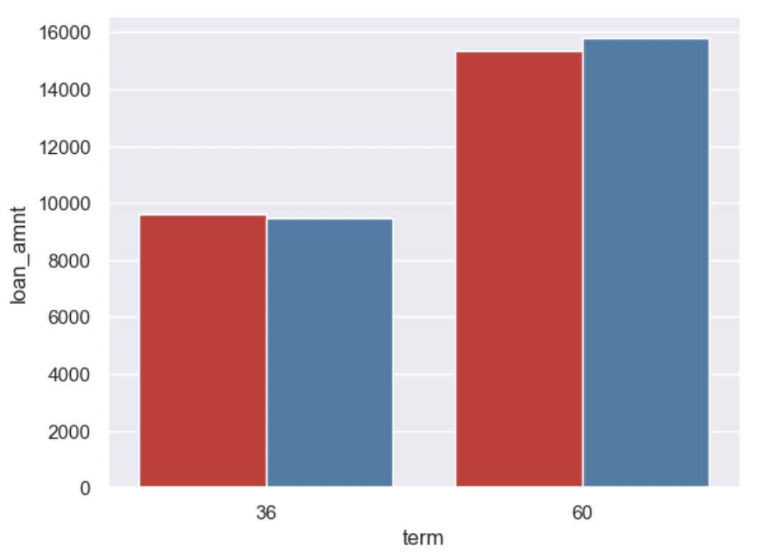
Multi-Variate Analysis: Loan Amount vs Term vs loan_status
Loan Amount vs Term vs loan_status
Notes:
Original Content:
Loan Amount vs Term vs loan_status

Slide 45
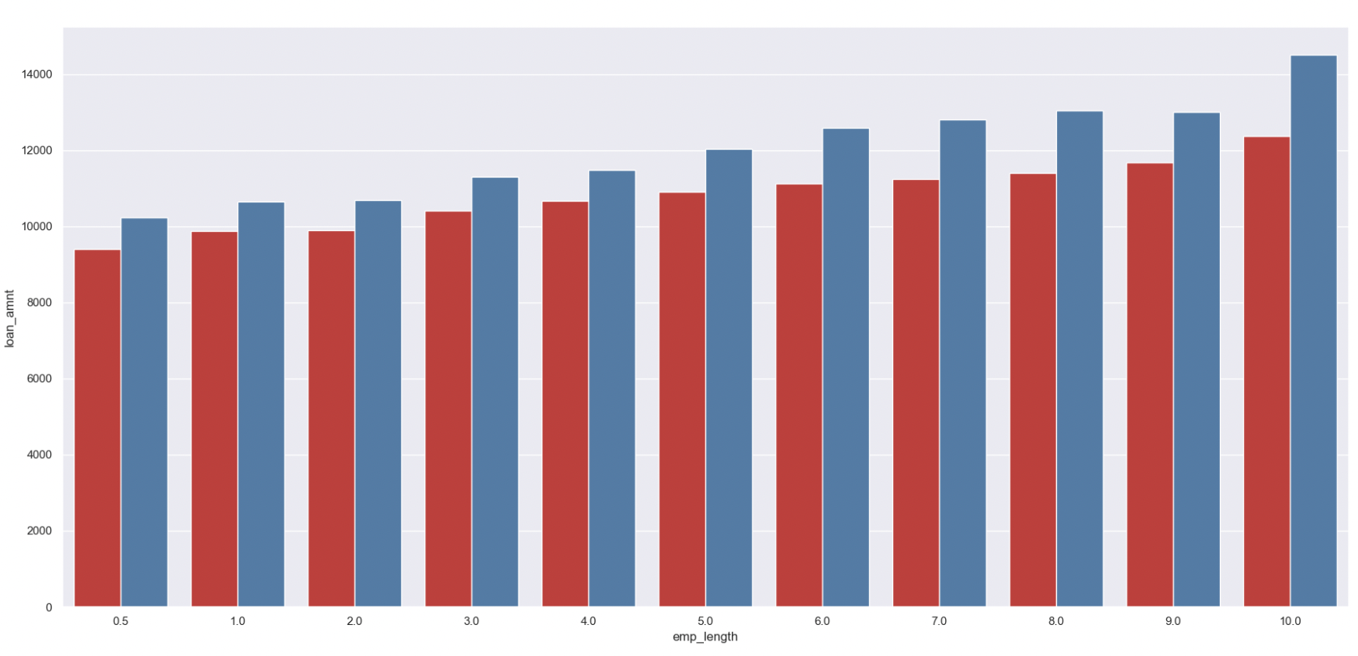
Multi-Variate Analysis: Loan Amount vs Employment Length vs loan_status
Loan Amount vs Employment Length vs loan_status
Notes:
This slide presents information about the relationship between loan amount, employment length, and loan status.
Original Content:
Loan Amount vs Employment Length vs loan_status

Slide 46
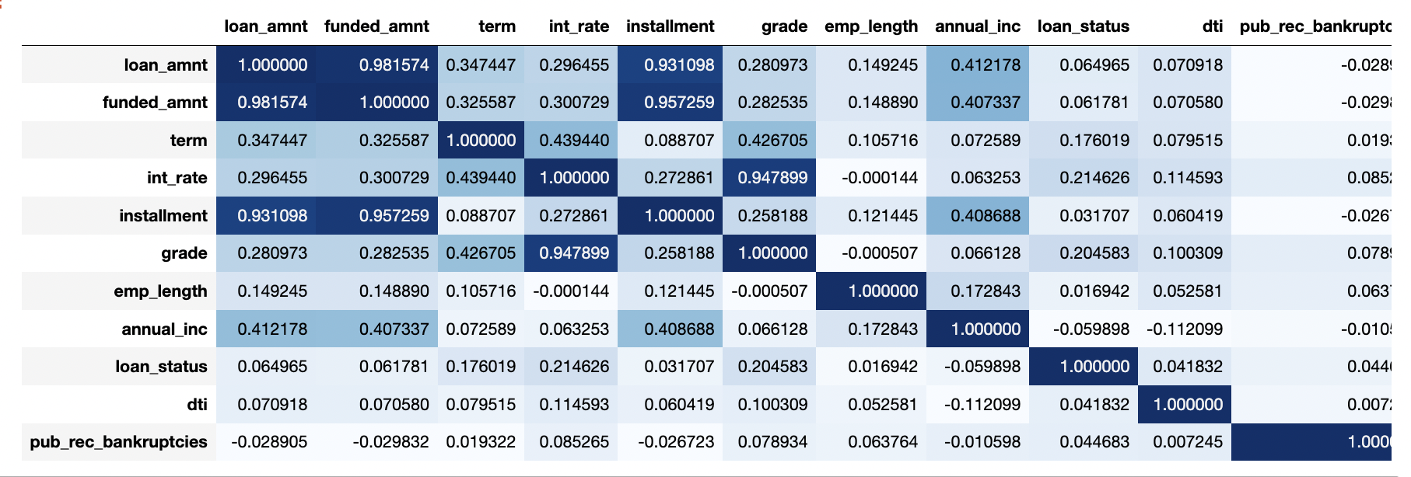
Correlation HeatMap
High correlation is observed between:
funded_amnt and loan_amnt
Loan_amnt and installment
Grade and interest rate
Notes:
This slide shows the correlation heatmap of correlated variables. High correlation is observed between funded amount and loan amount, loan amount and installment, and grade and interest rate.
Original Content:
Correlation HeatMap
Correlation heat map of Correlated variables
Key Points:
High correlation is observed between
funded_amnt and loan_amnt
Loan_amnt and installment
Grade and interest rate

Slide 47
Analysis Results
Notes:
This slide presents various statistics about loans, including loan amounts, terms, interest rates, and borrower information. The most common loan amount is around 9800, with 75% of loans having a term of 36 months. High grade loans are most common, with Grade B being the highest in number. Most borrowers have an employment length of 10+ years and live in rented accommodation. Debt consolidation is the most common reason for taking out a loan.
Original Content:
● The loan amount varies from 500 to 35000 with a mean of 9800.
● 75% of the loan taken has a term of 36 months compared to 60 months.
● Most Loans are issued at an interest rate of around 5-10 and 10-15 with a drop near
● High Grade Loans are high in numbers with Grade B being highest in number.
● Higher subgrades in each grade just confirm that higher grade loans are higher in number
● Most borrowers are the ones having the highest employment length with 10+ years being the most common.
● Borrowers living on rented accomodation are most common followed by those living in mortgaged accommodation. Owners are the least borrowers.
● Most borrowers have been verified by company or have the source verified
● Majority of borrowers have very low annual income.
● Borrowers are taking more loans to consolidate their existing debts. Debt_consolidation is the most specific reason for taking loan
● Most of the borrowers are from states california, new york, texas, florida.
● Debt-to-Income ratio of the majority of the borrowers is in 10-15 zone which means that the debt is high as compared to Income for these borrowers
● Out of 37173 records 31813 have no public bankruptcy records (85.5%) Rest 5360 (14.5%) have at least 1 public bankruptcy records Following is the statistics for the same. 15% defaulters have no Public bankruptcy records, 22% defaulters have 1 record, 40% defaulters have 2 public bankruptcy records. It is almost clear that each derogatory record almost doubles the chances of Charge Off.
● Last quarter of the year shows the highest disbursal of loans.
● Debt Consolidation has the highest number of both fully paid and defaulted loans. Credit card is the second in the list.
● While the 25th and mean percentile for Fully paid and Charged off cases are the same. However, a loan ticket of 10K to 17K shows higher Charged off incidence lying in the 50th to 75th percentile.
● Higher grade loans of type A,B,C,D are generally taken for shorter term of 36 months as compared to Grade B,C,D,E loans taken for 60 months term

Slide 48
Analysis Results: Univariate Analysis
Loan amounts range from 500 to 35000, with an average of 9800.
75% of loans have a term of 36 months.
Most loans have an interest rate of 5-10 and 10-15.
Grade B loans are the most common.
Borrowers with 10+ years of employment are most prevalent.
Most borrowers live in rented or mortgaged accommodations.
Borrowers' income sources are mostly verified.
Most borrowers have low annual income.
Debt consolidation is the most common reason for borrowing.
The majority of borrowers are from California, New York, Texas, and Florida.
Most borrowers have a high debt-to-income ratio.
85.5% of borrowers have no public bankruptcy records.
The last quarter of the year sees the highest loan disbursement.
Debt consolidation and credit card loans have the highest fully paid and defaulted rates.
Loan amounts between 10K and 17K have a higher default rate.
Shorter term loans are more common for higher grade loans
Notes:
This slide presents various statistics about loans, including loan amounts, terms, interest rates, and borrower information. The most common loan amount is around 9800, with 75% of loans having a term of 36 months. High grade loans are most common, with Grade B being the highest in number. Most borrowers have an employment length of 10+ years and live in rented accommodation. Debt consolidation is the most common reason for taking out a loan.
Original Content:
● The loan amount varies from 500 to 35000 with a mean of 9800.
● 75% of the loan taken has a term of 36 months compared to 60 months.
● Most Loans are issued at an interest rate of around 5-10 and 10-15 with a drop near
● High Grade Loans are high in numbers with Grade B being highest in number.
● Higher subgrades in each grade just confirm that higher grade loans are higher in number
● Most borrowers are the ones having the highest employment length with 10+ years being the most common.
● Borrowers living on rented accomodation are most common followed by those living in mortgaged accommodation. Owners are the least borrowers.
● Most borrowers have been verified by company or have the source verified
● Majority of borrowers have very low annual income.
● Borrowers are taking more loans to consolidate their existing debts. Debt_consolidation is the most specific reason for taking loan
● Most of the borrowers are from states california, new york, texas, florida.
● Debt-to-Income ratio of the majority of the borrowers is in 10-15 zone which means that the debt is high as compared to Income for these borrowers
● Out of 37173 records 31813 have no public bankruptcy records (85.5%) Rest 5360 (14.5%) have at least 1 public bankruptcy records Following is the statistics for the same. 15% defaulters have no Public bankruptcy records, 22% defaulters have 1 record, 40% defaulters have 2 public bankruptcy records. It is almost clear that each derogatory record almost doubles the chances of Charge Off.
● Last quarter of the year shows the highest disbursal of loans.
● Debt Consolidation has the highest number of both fully paid and defaulted loans. Credit card is the second in the list.
● While the 25th and mean percentile for Fully paid and Charged off cases are the same. However, a loan ticket of 10K to 17K shows higher Charged off incidence lying in the 50th to 75th percentile.
● Higher grade loans of type A,B,C,D are generally taken for shorter term of 36 months as compared to Grade B,C,D,E loans taken for 60 months term

Slide 49
Analysis Results: Segmented Univariate Analysis
Higher interest rates lead to more defaults.
Borrowers with high debt-to-income ratio (>20) are more likely to default.
High installment payments are associated with higher default rates.
Borrowers with annual income less than 50K are more likely to default.
Lower grade loans with high interest rates are riskier.
Higher loan amounts and longer terms have more defaults and fully paid loans.
Borrowers who own their property default less than those on rent or mortgage.
Borrowers with low annual income are more likely to default.
Larger loan amounts have a higher chance of defaulting.
Debt consolidation is the most common purpose and has the highest number of defaults.
Fully paid loans are increasing exponentially compared to defaulted loans.
Default loan amount increases with interest rate and declines after 17.5%.
Borrowers with more than 10 years of employment take larger loans.
Most defaulters with large loans have more than 10 years of employment.
Notes:
In this slide, we will discuss the factors that affect loan default. Borrowers with higher interest rates, high DTI, and low annual income are more likely to default. Lower grade and higher interest rate also increase risk. Higher loan amounts and longer terms also increase risk. Property ownership and annual income also play a role in default risk. Let's take a closer look at each of these factors.
Original Content:
● Borrowers facing Higher interest rate tend to default more as compared to one with a lower interest rate.
● Borrowers with high DTI(>20) are likely to default more than the borrowers with less DTI(<10) or (<20)
● There is not much difference in the number of defaulters paying high installments. However, technically, high installments are related to high defaults.
● Borrowers with low Annual income (in the range < 50K) are likely to default more.
● Lower Grade = Higher Risk. Thus Lower grade with high interest rate increases the risk.
● Higher loan amounts with longer terms have more charged off as well as fully paid loans.
● The Defaulted loans are lower for the borrowers which own their property compared to on mortgage or rent.
● Borrowers with less than 50000 annual income are more likely to default and higher annual income are less likely to default.
● The mean and 25% are the same for both but we see a larger 75% in the defaulted loan which indicates a large amount of loan has a higher chance of defaulting.

Slide 50
Analysis Results: Bivariate Analysis
The Grade represents the risk factor. Lower grade high risk of default.
The borrowers with no record of Public Recorded Bankruptcy can be a safe choice for lending.
Notes:
In this slide, we will discuss the factors that affect loan default. Borrowers with higher interest rates, high DTI, and low annual income are more likely to default. Lower grade and higher interest rate also increase risk. Higher loan amounts and longer terms also increase risk. Property ownership and annual income also play a role in default risk. Let's take a closer look at each of these factors.
Original Content:
● Borrowers facing Higher interest rate tend to default more as compared to one with a lower interest rate.
● Borrowers with high DTI(>20) are likely to default more than the borrowers with less DTI(<10) or (<20)
● There is not much difference in the number of defaulters paying high installments. However, technically, high installments are related to high defaults.
● Borrowers with low Annual income (in the range < 50K) are likely to default more.
● Lower Grade = Higher Risk. Thus Lower grade with high interest rate increases the risk.
● Higher loan amounts with longer terms have more charged off as well as fully paid loans.
● The Defaulted loans are lower for the borrowers which own their property compared to on mortgage or rent.
● Borrowers with less than 50000 annual income are more likely to default and higher annual income are less likely to default.
● The mean and 25% are the same for both but we see a larger 75% in the defaulted loan which indicates a large amount of loan has a higher chance of defaulting.

Slide 51

Correlation
High correlation is observed between
funded_amnt and loan_amnt
Loan_amnt and installment
Grade and interest rate
Notes:
There is a high correlation between funded amount and loan amount, loan amount and installment, and grade and interest rate.
Original Content:
High correlation is observed between
● funded_amnt and loan_amnt
● Loan_amnt and installment
● Grade and interest rate

Slide 52
Suggestions and Recommendations
Notes:
This slide presents various statistics about loans, including loan amounts, terms, interest rates, and borrower information. The most common loan amount is around 9800, with 75% of loans having a term of 36 months. High grade loans are most common, with Grade B being the highest in number. Most borrowers have an employment length of 10+ years and live in rented accommodation. Debt consolidation is the most common reason for taking out a loan.
Original Content:
● The loan amount varies from 500 to 35000 with a mean of 9800.
● 75% of the loan taken has a term of 36 months compared to 60 months.
● Most Loans are issued at an interest rate of around 5-10 and 10-15 with a drop near
● High Grade Loans are high in numbers with Grade B being highest in number.
● Higher subgrades in each grade just confirm that higher grade loans are higher in number
● Most borrowers are the ones having the highest employment length with 10+ years being the most common.
● Borrowers living on rented accomodation are most common followed by those living in mortgaged accommodation. Owners are the least borrowers.
● Most borrowers have been verified by company or have the source verified
● Majority of borrowers have very low annual income.
● Borrowers are taking more loans to consolidate their existing debts. Debt_consolidation is the most specific reason for taking loan
● Most of the borrowers are from states california, new york, texas, florida.
● Debt-to-Income ratio of the majority of the borrowers is in 10-15 zone which means that the debt is high as compared to Income for these borrowers
● Out of 37173 records 31813 have no public bankruptcy records (85.5%) Rest 5360 (14.5%) have at least 1 public bankruptcy records Following is the statistics for the same. 15% defaulters have no Public bankruptcy records, 22% defaulters have 1 record, 40% defaulters have 2 public bankruptcy records. It is almost clear that each derogatory record almost doubles the chances of Charge Off.
● Last quarter of the year shows the highest disbursal of loans.
● Debt Consolidation has the highest number of both fully paid and defaulted loans. Credit card is the second in the list.
● While the 25th and mean percentile for Fully paid and Charged off cases are the same. However, a loan ticket of 10K to 17K shows higher Charged off incidence lying in the 50th to 75th percentile.
● Higher grade loans of type A,B,C,D are generally taken for shorter term of 36 months as compared to Grade B,C,D,E loans taken for 60 months term

Slide 53
Suggestions & Recommendations
Data points that can be used to predict whether there will be a default and avoiding Credit Loss:
With respect to borrowers following considerations can be considered as risk for 'defaults' :
DTI
Grades
Verification Status
Annual income
Pub_rec_bankruptcies
Should not be from large urban cities like California, New York, Texas, Florida etc.
Not having annual income in the range 50000-100000.
Not having Public Recorded Bankruptcy.
Have least grades like E,F,G which indicates high risk.
Have very high Debt to Income value.
Have working experience of 10+ years.
Notes:
This slide presents various statistics about loans, including loan amounts, terms, interest rates, and borrower information. The most common loan amount is around 9800, with 75% of loans having a term of 36 months. High grade loans are most common, with Grade B being the highest in number. Most borrowers have an employment length of 10+ years and live in rented accommodation. Debt consolidation is the most common reason for taking out a loan.
Original Content:
● The loan amount varies from 500 to 35000 with a mean of 9800.
● 75% of the loan taken has a term of 36 months compared to 60 months.
● Most Loans are issued at an interest rate of around 5-10 and 10-15 with a drop near
● High Grade Loans are high in numbers with Grade B being highest in number.
● Higher subgrades in each grade just confirm that higher grade loans are higher in number
● Most borrowers are the ones having the highest employment length with 10+ years being the most common.
● Borrowers living on rented accomodation are most common followed by those living in mortgaged accommodation. Owners are the least borrowers.
● Most borrowers have been verified by company or have the source verified
● Majority of borrowers have very low annual income.
● Borrowers are taking more loans to consolidate their existing debts. Debt_consolidation is the most specific reason for taking loan
● Most of the borrowers are from states california, new york, texas, florida.
● Debt-to-Income ratio of the majority of the borrowers is in 10-15 zone which means that the debt is high as compared to Income for these borrowers
● Out of 37173 records 31813 have no public bankruptcy records (85.5%) Rest 5360 (14.5%) have at least 1 public bankruptcy records Following is the statistics for the same. 15% defaulters have no Public bankruptcy records, 22% defaulters have 1 record, 40% defaulters have 2 public bankruptcy records. It is almost clear that each derogatory record almost doubles the chances of Charge Off.
● Last quarter of the year shows the highest disbursal of loans.
● Debt Consolidation has the highest number of both fully paid and defaulted loans. Credit card is the second in the list.
● While the 25th and mean percentile for Fully paid and Charged off cases are the same. However, a loan ticket of 10K to 17K shows higher Charged off incidence lying in the 50th to 75th percentile.
● Higher grade loans of type A,B,C,D are generally taken for shorter term of 36 months as compared to Grade B,C,D,E loans taken for 60 months term

